Slide 1
Word NIELSEN’S TEN USABILITY HEURISTICS

Slide 2
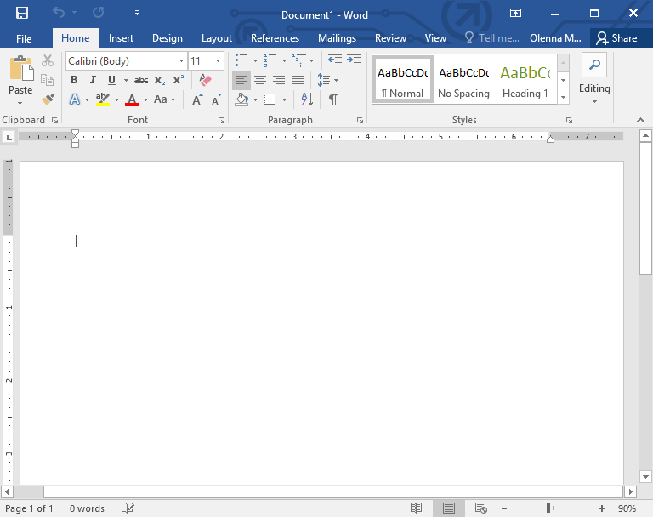
1. Visibility of System Status
The system always displays basic functions
Use is instant and visible
Loads fast

Slide 3
#2 Match between system and the real world
System displays functions description using the systems language
Buttons appeal to logic and precise

Slide 4
#3 User control and freedom
Errors can be resolved according to the users needs with an extensive memory
Users can edit the document to any style they desire
Undo and redo buttons are there

Slide 5
#4 Consistency and standards
System follows regular word editing conventions
Has extra options and functionality for formatting
The older versions weren’t too different than the newer ones

Slide 6
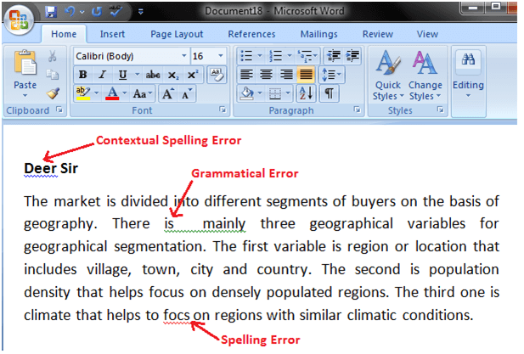
#5 Error prevention
System can check for grammatical and spelling error
System can correct simple errors without user input
System will double check if document has been saved to prevent data loss

Slide 7
#6 Recognition rather than recall
Users can recognize functionality of simple buttons
Users can recall complex functions after few uses

Slide 8
#7 Flexibility and efficiency of use
System has the ability to autocomplete words and posseses multiple shortcuts
System can convert multiple files types and convert old versions into new
User friendly to all ages or all levels of technology mastery
Requires basic human instinct to operate

Slide 9
#8 Aesthetic and minimalist design
Design of system is clean and creates minimal confusion with only two main colours
Design of system has a recollection of real-world document formats

Slide 10
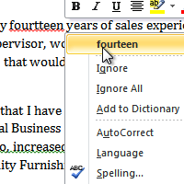
#9 Help users recognize, diagnose and recover from errors
Errors are displayed visibly
Suggestions are displayed after further input with a description to rationalize with the users on the effects of fixing the errors and/or ignoring errors

Slide 11
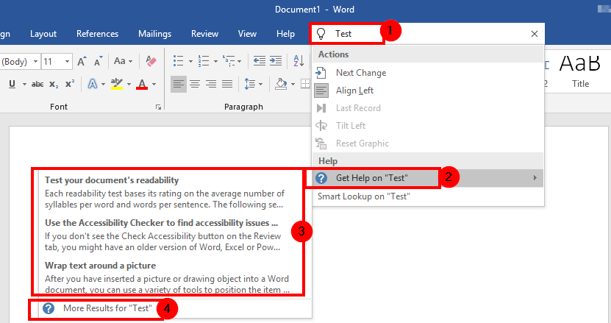
#10 Help and documentation
Provides customer services or assistance under clear view
Has an extensive documentation on all functions for users who want to expand their knowledge
FAQ sections are available to save time on fixing errors

